Slide 1
Concurrency Control for Scalable Bayesian Inference
Joseph E. Gonzalez
Postdoc, UC Berkeley AMPLab
Co-founder, GraphLab Inc.
jegonzal@eecs.berkeley.edu
ISBA’ 2014

Slide 2
A Systems Approach to Scalable Bayesian Inference
Joseph E. Gonzalez
Postdoc, UC Berkeley AMPLab
Co-founder, GraphLab Inc.
jegonzal@eecs.berkeley.edu
ISBA’ 2014

Slide 3

http://www.domo.com/learn/data-never-sleeps-2

Slide 4
http://www.domo.com/learn/data-never-sleeps-2

Slide 5
http://www.domo.com/learn/data-never-sleeps-2

Slide 6
http://www.domo.com/learn/data-never-sleeps-2

Slide 7
Data Velocity is an opportunity for Bayesian Nonparametrics.
How do we scale Bayesian inference?

Slide 8

Opposing Forces
Accuracy
Scalability
Ability to estimate the posterior distribution
Ability to effective use parallel resources
Parameter Server
Serial
Inference
Coordination Free
Samplers

Slide 9
Serial Inference
Model
State
Data

Slide 10
Coordination Free Parallel Inference
Model
State
Data
Processor 1
Processor 2

Slide 11
Coordination Free Parallel Inference
Model
State
Data
Processor 1
Processor 2
Keep Calm and Carry On.

Slide 12
Parameter Servers
System for Coordination Free Inference
D. Newman, A. Asuncion, P. Smyth, and M. Welling. Distributed inference for latent Dirichlet allocation. In NIPS, 2007.
A. Smola and S. Narayanamurthy. An architecture for parallel topic models. VLDB’10
Ahmed, M. Aly, J. Gonzalez, S. Narayanamurthy, and A. J. Smola. Scalable inference in latent variable models. WSDM '12
Ho et al. “More Effective Distributed ML via a Stale Synchronous Parallel Parameter Server.” NIPS’13

Slide 13
Hierarchical Clustering
Global Variables
Local Variables

Slide 14
Example: Topic Modeling with LDA
Word Dist. by Topic
Local Variables Documents
Tokens
Maintained by the Parameter Server
Maintained by the Workers Nodes

Slide 15
Ex: Collapsed Gibbs Sampler for LDA
Partitioning the model and data
Parameter Server
Parameter Server
Parameter Server
W_{1:10K}
W_{10k:20K}
W_{20k:30K}
w₄
w₅
w₁
w₆
w₂
w₃
w₇
w₉
w₈
w₄
w₆
w₃
w₅
w₈
w₉
w₁
w₇
w₂

Slide 16
Ex: Collapsed Gibbs Sampler for LDA
Partitioning the model and data
Parameter Server
Parameter Server
Parameter Server
W_{1:10K}
W_{10k:20K}
W_{20k:30K}
Parameter Cache
Parameter Cache
Parameter Cache
Parameter Cache
Car
Dog
Bat
Pig
Cat
Gas
VW
Zoo
Car
Rim
$$
bmw
Mac
iOS
Cat
iPod

Slide 17
Ex: Collapsed Gibbs Sampler for LDA
Inconsistent model replicas
Parameter Server
Parameter Server
Parameter Server
W_{1:10K}
W_{10k:20K}
W_{20k:30K}
Inconsistent Values
Parameter Cache
Parameter Cache
Parameter Cache
Parameter Cache
Car
Dog
Bat
Pig
Cat
Cat
Gas
VW
Zoo
Car
Rim
$$
bmw
Mac
iOS
Cat
Cat
iPod

Slide 18
Parallel Gibbs Sampling Incorrect Posterior
t=1
t=2
t=3
Strong Positive
Correlation
t=0
Sequential
Execution
Strong Positive
Correlation
Strong Negative
Correlation
Parallel
Execution
dependent variables cannot in general be sampled simultaneously.

Slide 19
Issues with Nonparametrics
Difficult to introduce new clusters asynchronously:
Leads to too many clusters!
Parameter Server
Parameter Server
Parameter Server
Create Cluster 7
Create Cluster 7
7
7

Slide 20
Opposing Forces
Accuracy
Scalability
Parameter Server
Serial
Inference
Asynchronous
Samplers

Slide 21
Opposing Forces
Accuracy
Scalability
Accuracy
Scalability

Slide 22
Opposing Forces
Serial
Inference
Accuracy
Parameter Server
Asynchronous
Samplers
Scalability

Slide 23
Opposing Forces
?
Serial
Inference
Concurrency Control
Accuracy
Parameter Server
Asynchronous
Samplers
Scalability

Slide 24
Concurrency Control
Coordination Free (Parameter Server):
Provably fast and correct under key assumptions.
Concurrency Control:
Provably correct and fast under key assumptions.
Systems Ideas to
Improve Efficiency

Slide 25
Opposing Forces
Unsafe
Safe
Concurrency Control
Serial
Inference
Mutual
Exclusion
Optimistic
Concurrency Control
Accuracy
Parameter Server
Asynchronous
Samplers
Scalability

Slide 26
Mutual Exclusion
Conditional Independence
J. Gonzalez, Y. Low, A. Gretton, and C. Guestrin. Parallel Gibbs Sampling: From Colored Fields to Thin Junction Trees. AISTATS’11
Exploit the Markov random field for Parallel Gibbs Sampling
Graph
Coloring
R/W Lock
Mutual Exclusion

Slide 27

Mutual Exclusion through Scheduling Chromatic Gibbs Sampler
Compute a k-coloring of the graphical model
Sample all variables with same color in parallel
Serial Equivalence:
Time

Slide 28
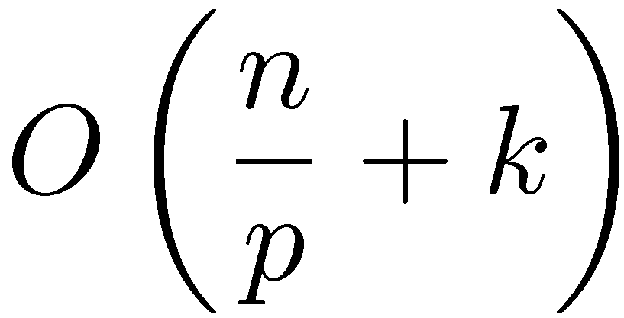
Theorem: Chromatic Sampler
Ergodic: converges to the correct distribution
Based on graph coloring of the Markov Random Field
Quantifiable acceleration in mixing
Time to update all variables once
# Variables
# Colors
# Processors

Slide 29

Mutual Exclusion Through Locking
Model
State
Data
Processor 1
Processor 2
Introducing locking (scheduling) protocols to identify potential conflicts.

Slide 30
Mutual Exclusion Through Locking
Model
State
✗
Data
Processor 1
Processor 2
Enforce serialization of computation that could conflict.

Slide 31
Markov Blanket Locks
Read/Write Locks:
R
R
R
W
R
R
W
R
R
R

Slide 32
Markov Blanket Locks
Eliminate fixed schedule and global coordination
Supports more advanced block sampling
Expected Parallelism:
Max Degree
# Processors
# Variables

Slide 33

A System for Mutual Exclusion on Markov Random Fields
GraphLab/PowerGraph [UAI’10, OSDI’12]:
Chromatic Sampling
Markov Blanket Locks + Block Sampling

Slide 34
Limitation Densely Connected MRF
V-Structures: observations couple many variables
Collapsed models: clique-like MRFs
Mutual exclusion pessimistically serializes computation that could interfere.
Can we be optimistic and only serialize computation that does interfere?
Notes:
----- Meeting Notes (7/17/14 14:32) -----
think about saying something different for serialize compute that does interefer

Slide 35
Opposing Forces
Unsafe
Safe
Serial
Inference
Mutual
Exclusion
Optimistic
Concurrency Control
Accuracy
Parameter Server
Asynchronous
Samplers
Scalability

Slide 36

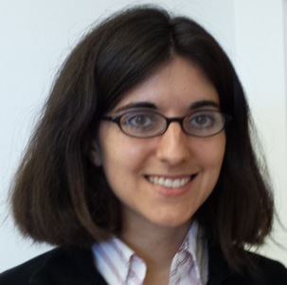


Optimistic Concurrency Control
assume the best and correct
X. Pan, J. Gonzalez, S. Jegelka, T. Broderick, M. Jordan. Optimistic Concurrency Control for Distributed Unsupervised Learning. NIPS’13
Xinghao
Pan
Tamara
Broderick
Stefanie
Jegelka
Michael
Jordan

Slide 37
Optimistic Concurrency Control
Classic idea from Database Systems:
Kung & Robinson. On optimistic methods for concurrency control. ACM Transactions on Database Systems. 1981
Assume most operations won’t conflict:
Execute operations without blocking
Frequent case is fast
Identify and resolve conflicts after they occur
Infrequent case with potentially costly resolution

Slide 38
Optimistic Concurrency Control
Model
State
Data
Processor 1
Processor 2
Allow computation to proceed without blocking.
Kung & Robinson. On optimistic methods for concurrency control. ACM Transactions on Database Systems 1981

Slide 39
Optimistic Concurrency Control
Model
State
✔
?
Valid outcome
Data
Processor 1
Processor 2
Validate potential conflicts.
Kung & Robinson. On optimistic methods for concurrency control. ACM Transactions on Database Systems 1981

Slide 40
Optimistic Concurrency Control
✗
Invalid Outcome
?
?
✗
Model
State
Data
Processor 1
Processor 2
Validate potential conflicts.
Kung & Robinson. On optimistic methods for concurrency control. ACM Transactions on Database Systems 1981

Slide 41
Optimistic Concurrency Control
✗
Amend the Value
✗
Model
State
Data
Processor 1
Processor 2
Take a compensating action.
Kung & Robinson. On optimistic methods for concurrency control. ACM Transactions on Database Systems 1981

Slide 42
Optimistic Concurrency Control
✗
Invalid Outcome
✗
Model
State
Data
Processor 1
Processor 2
Validate potential conflicts.
Kung & Robinson. On optimistic methods for concurrency control. ACM Transactions on Database Systems 1981

Slide 43
Optimistic Concurrency Control
✗
Rollback and Redo
✗
Model
State
Data
Processor 1
Processor 2
Take a compensating action.
Kung & Robinson. On optimistic methods for concurrency control. ACM Transactions on Database Systems 1981

Slide 44
Optimistic Concurrency Control
Rollback and Redo
Model
State
Data
Processor 1
Processor 2
Non-Blocking Computation
Concurrency
Requirements:
Fast
Validation: Identify Errors
Resolution: Correct Errors
Accuracy
Infrequent

Slide 45
Optimistic Concurrency Control for Bayesian Inference
Non-parametric Models [Pan et al., NIPS’13]:
OCC DP-Means: Dirichlet Process Clustering
OCC BP-Means: Beta Process Feature Learning
Conditional Sampling: (In Progress)
Collapsed Gibbs LDA
Retrospective Sampling for HDP

Slide 46
DP-Means Algorithm
[Kulis and Jordan, ICML’12]
Start with DP Gaussian mixture model:
small variance limit
Notes:
Base distribution, scale term

Slide 47
DP-Means Algorithm
[Kulis and Jordan, ICML’12]
Start with DP Gaussian mixture model:
small variance limit redefine :
Decreases
Rapidly

Slide 48
DP-Means Algorithm
[Kulis and Jordan, ICML’12]
Corresponding Gibbs sampler conditionals:
Taking the small variance limit
Notes:
\textcolor{blue}{\alpha}(\textcolor{red}{\sigma})

Slide 49
DP-Means Algorithm
[Kulis and Jordan, ICML’12]
Gibbs updates become deterministic:
Taking the small variance limit
Notes:
\textcolor{blue}{\alpha}(\textcolor{red}{\sigma})

Slide 50
DP-Means Algorithm
[Kulis and Jordan, ICML’12]
Gibbs updates become deterministic:
Notes:
\textcolor{blue}{\alpha}(\textcolor{red}{\sigma})

Slide 51
DP-Means Algorithm
[Kulis and Jordan, ICML’12]
Computing cluster membership
λ
Notes:
\textcolor{blue}{\alpha}(\textcolor{red}{\sigma})

Slide 52
DP-Means Algorithm
[Kulis and Jordan, ICML’12]
Updating cluster centers:
Notes:
\textcolor{blue}{\alpha}(\textcolor{red}{\sigma})

Slide 53
DP-Means Parallel Execution
Computing cluster membership in parallel:
Cannot introduce overlapping clusters in parallel
CPU 2
<λ
CPU 1
Notes:
\textcolor{blue}{\alpha}(\textcolor{red}{\sigma})

Slide 54
Optimistic Concurrency Control for Parallel DP-Means
Optimistic Assumption
No new cluster created nearby
Validation
Verify that new clusters don’t overlap
Resolution
Assign new cluster center to existing cluster
<λ
CPU 1
CPU 2
Notes:
\textcolor{blue}{\alpha}(\textcolor{red}{\sigma})

Slide 55
OCC DP-means
Theorem: OCC DP-means is serializable and therefore preserves theoretical properties of DP-means.
Theorem: Assuming well spaced clusters the expected overhead of OCC DP-means does not depend on data size.
Correctness
Concurrency

Slide 56
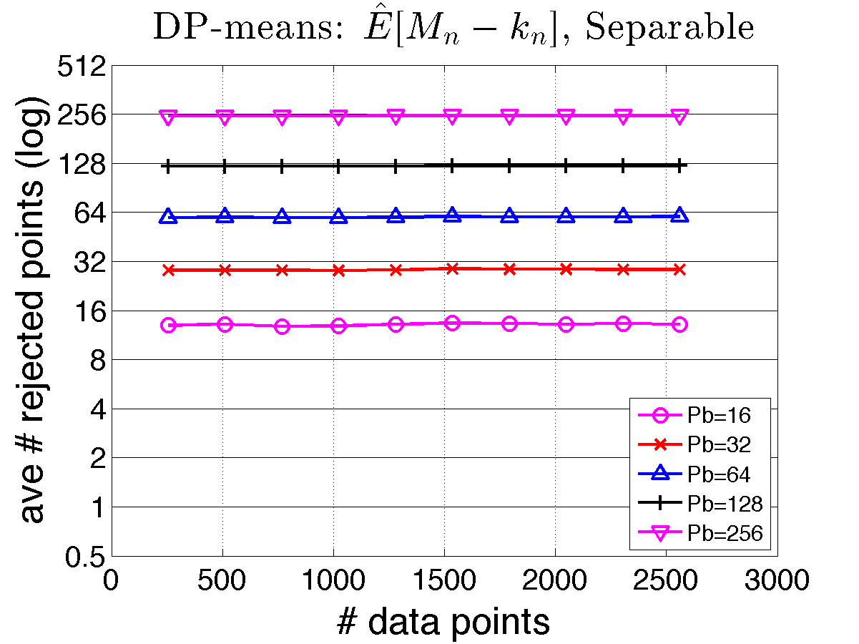
Empirical Validation Failure Rate
λ Separable Clusters
32 Processors
16 Processors
8 Processors
4 Processors
OCC Overhead
Parallelism
Points Failing Validation
2 Processors
Dataset Size

Slide 57
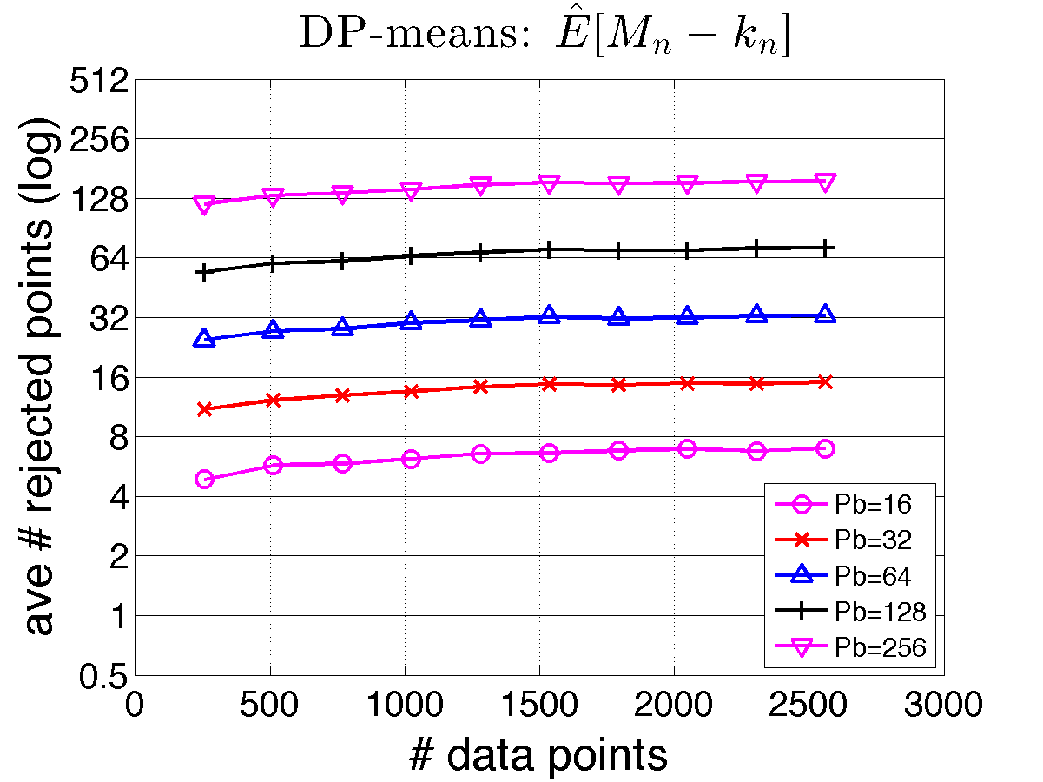
Empirical Validation Failure Rate
Overlapping Clusters
32 Processors
16 Processors
8 Processors
OCC Overhead
Parallelism
Points Failing Validation
4 Processors
2 Processors
Dataset Size

Slide 58
Distributed Evaluation Amazon EC2
~140 million data points; 1, 2, 4, 8 machines
OCC DP-means Runtime
Projected Linear Scaling
2x #machines
≈ ½x runtime

Slide 59
Optimistic Future for Optimistic Concurrency Control
Unsafe
Safe
Optimistic Concurrency Control
Accuracy
Scalability
Parameter Server
Serial
Inference

Slide 60
Thank You Questions?
Joseph E. Gonzalez
jegonzal@eecs.berkeley.edu

Slide 61
OCC Collapsed Gibbs for LDA
Maintain epsilon intervals on the conditional:
System ensures conditionals are ε-accurate
Validate: Accept draws that land outside interval
Resolution: Serially resample rejected tokens
ε
ε
ε
ε
0
1
u
u

Slide 62
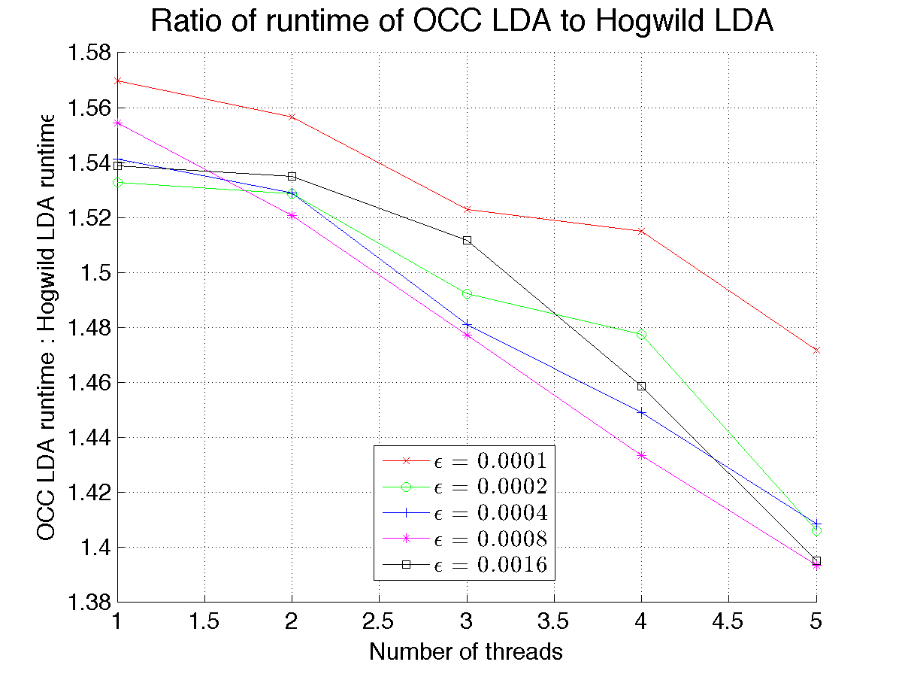
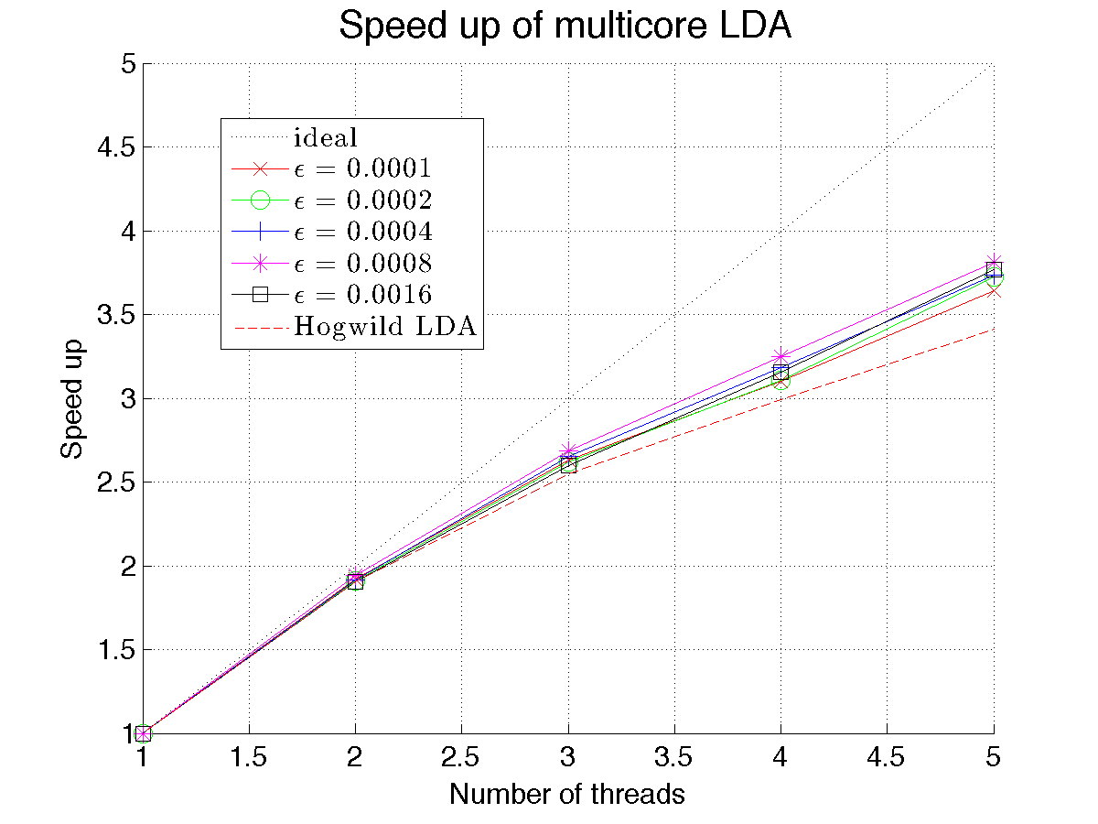
OCC Collapsed Gibbs for LDA

Slide 63
Optimism for Optimistic Concurrency Control
Validation
Frequent
Rare
Fast + Easy
Coordination Free
Slow + Complex
Resolution
Enable decades of work in serial Bayesian inference to be extended to the parallel setting.

